Slide 1
Web Development In JAVA

Slide 2
Standalone application
A standalone application is an application that runs locally on the device and doesn’t require anything else to be functional.
Application that can run offline
It usually runs on single computer.
Java, VB and c# are the popular languages to develop this type of applications

Slide 3
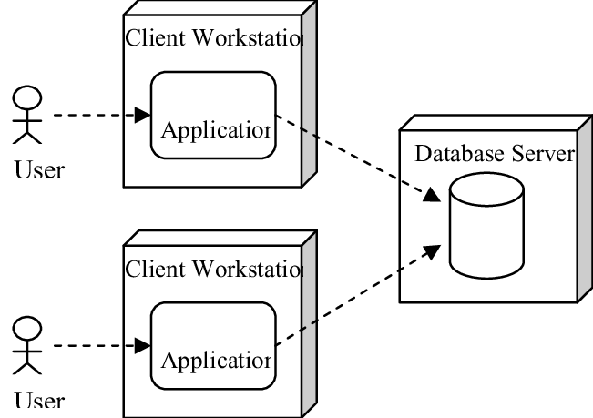
Standalone application architecture

Slide 4
Web Application
A web application is a computer program that uses a web browser to perform a particular function
You need internet and a browser to run a web application.
For run application on the client side commonly used java script
Java, java script, python, Ruby are the languages that commonly used to run application on web-server

Slide 5
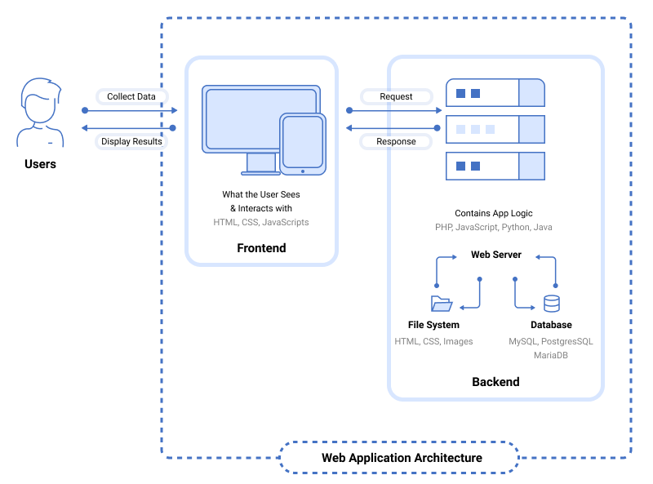
Web Application Architecture

Slide 6
How a web application works
The user creates a request to the web server over the Internet through the application's user interface
The web server sends this request to the web application server
The web application server executes the requested task, then generates the results of the required data
The web application server sends those results back to the web server
The web server carries the requested information to the client
The requested information appears on the user's display

Slide 7
Web server
The main job of a web server is to display website content through storing, processing and delivering webpages to users
Apache Tomcat, Nginx, JBOSS Popular web servers

Slide 8
IDE
IDE stands for integrated development environment
We use IDE’s for make our work more easier
IntelliJ, Eclipse, NetBeans are the most popular IDE’s

Slide 9
Enterprise Application
enterprise application software, is computer software used to satisfy the needs of an organization rather than individual users
Organization includes such as businesses, schools, hospitals, banks

Slide 10
Webservices
service offered by an electronic device to another electronic device, communicating with each other via the Internet.

Slide 11
J2SE
Also well-known as Core Java, this is the most basic and standard version of Java. It’s the purest appearance of Java, a basic establishment for all other editions
It consists of a large range of common purpose API’s (like java.lang, java.util) as well as many particular purpose APIs.
This is mainly used for Develop Standalone application

Slide 12
J2EE
Mainly used for develop web applications
It is the super set of J2SE
Spring-boot is a framework that developed using j2EE

Slide 13
J2ME
It stands for - j2 platform micro edition
It is commonly used to develop embedded systems

Slide 14
THE END

